Slide 1
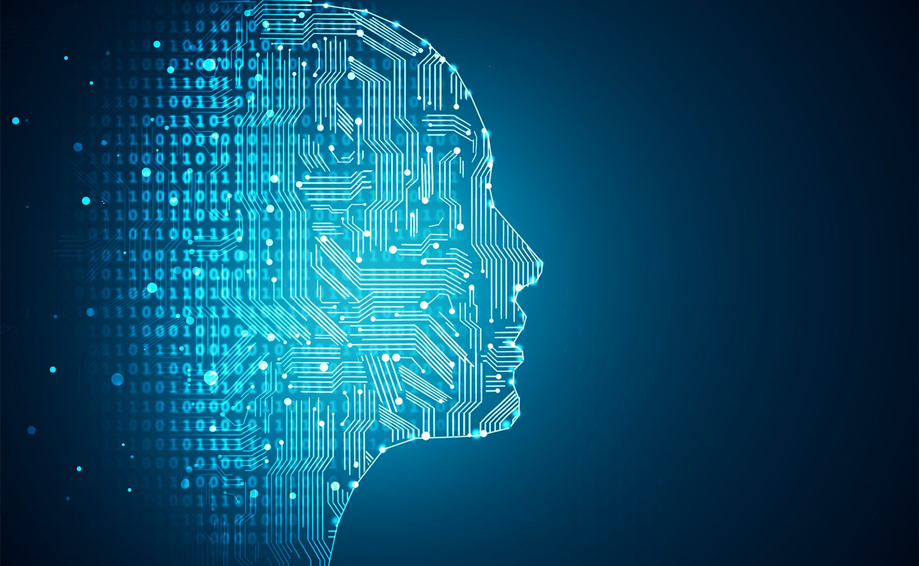
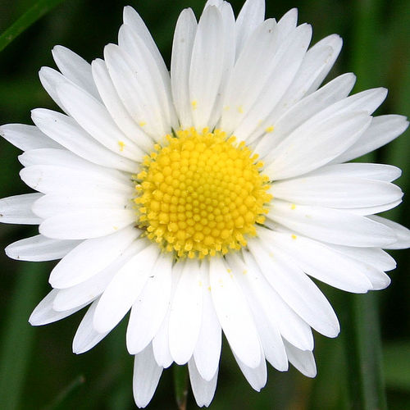
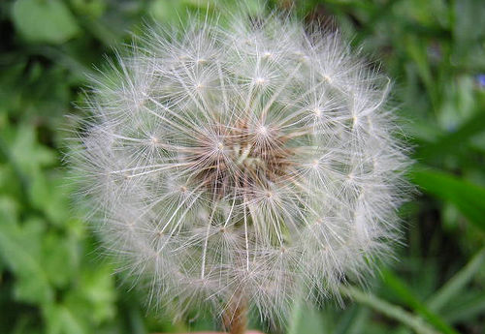
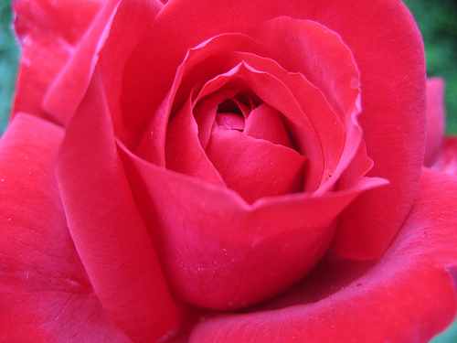
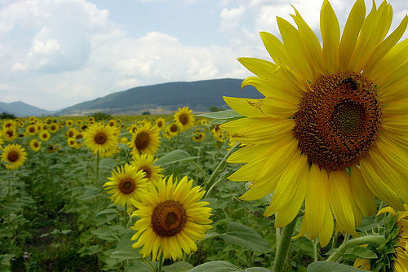
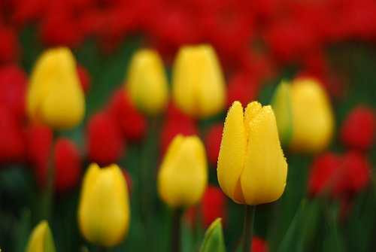
Machine Learning Flower Classifications
Final Project Presentation
Nelson Wang, July 14, 2018

Slide 2
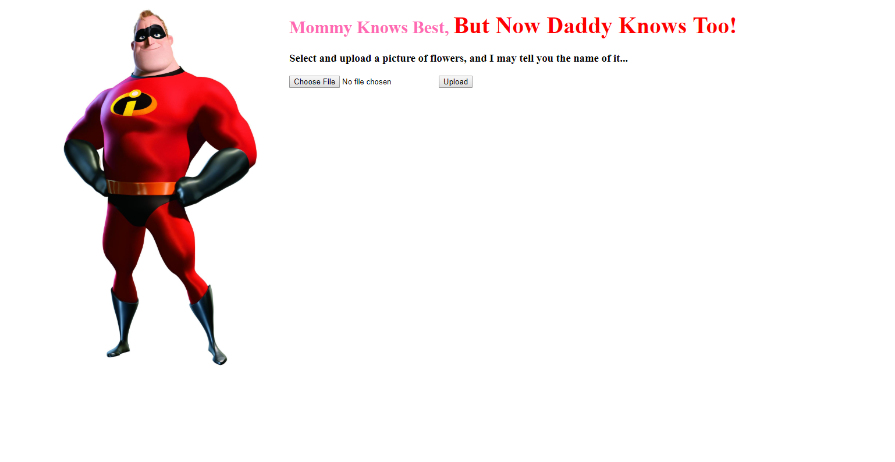
What if we had an app like this…

Slide 3
Objectives
Experiment with 10 pre-trained Keras CNN models and compare their effectiveness in classifying flower types
Pick the best pre-trained model, and fine tune it to improve its classification accuracy
Create a website where uses can upload pictures and find out the name of flowers

Slide 4
Data source
Flower dataset downloaded from Kaggle.com*
Five Species: Daisy, Dandelion, Rose, Sunflower, Tulip
~800 pictures for each type
Flower pictures scraped from ImageNet.com
Five Species: Daisy, Dandelion, Rose, Sunflower, Tulip
1000+ pictures for each type
* https://www.kaggle.com/alxmamaev/flowers-recognition/home

Slide 5
Experiment steps
Downloaded initial data from Kaggle and split it into training dataset and test dataset. With the test dataset, directly applied the pre-trained CNN models to compare and pick which one works best in predicting the flower types.
Scraped pictures from ImageNet website and downloaded data for further validation
Installed library from https://github.com/tzutalin/ImageNet_Utils, tweaked the codes to work for Python 3
Used the ID of flowers to download pictures

Slide 6
Experiment steps
Picked InceptionResNetV2 to start fine tuning work, tweaked different parameters to improve prediction accuracy and reduce lose
# of layers to train
# of nodes in the new layer
Drop out rate
Batch size
Optimizer
Learning rate
# of epochs

Slide 7
Experiment steps
Switched to simpler model to reduce overfit
Increased the amount of training data to reduce overfit
Used the new model to predict test picture in Kaggle’s dataset
Used Flask to serve a website where users can upload pictures and find out the name of the flowers

Slide 8
Lessons learned
If you have a fast computer with GPU and enough time:
Use more training data if available
Tweak the parameters as much as you can
Usually simpler models or algorithms work better
Always validate the model results before celebrating for success
Recognize the limitations of supervised learning and classification algorithms

